Slide 1


Slide 2

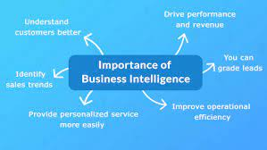

Slide 3


Slide 4
Introduction to Projects
Statistical Project related to Sales
Power BI Projects to Visualize the data and make interactive Reports
Tableau Project to represent trends through various charts, forecast your sales, make Dashboards and Make Story

Slide 5


Slide 6

Education
MSc IT
MPhil CS
Ph.D. CS

Slide 7
Experience

Slide 8

What to Cover?
What is Business Intelligence?
Statistical Techniques
Practices with Excel
Power BI
tableau

Slide 9

Target Audience

